Slide 1
Page replacement

Slide 2
Review
Concept of virtual memory, demand paging.
Page fault
Performance degradation due to page fault: Need to reduce #page faults to a minimum
Page fault handling process, broad steps: (1) Trap (2) Locate on disk (3) find free frame (4) schedule disk I/O (5) update page table (6) resume
More on (3) today

Slide 3
List of free frames
Kernel needs to maintain a list of free frames
At the time of loading the kernel, the list is created
Frames are used for allocating memory to a process
  But may also be used for managing kernel’s own data structures also
More processes --> more demand for frames

Slide 4
What if no free frame found on page fault?
Page frames in use depends on “Degree of multiprogramming”
  More multiprogramming -> overallocation of frames
  Also in demand from the kernel, I/O buffers, etc
  How much to allocate to each process? How many processes to allow?
Page replacement – find some page(frame) in memory, but not really in use, page it out
  Questions : terminate process? Page out process? replace the page?
  For performance, need an algorithm which will result in minimum number of page faults
Bad choices may result in same page being brought into memory several times

Slide 5
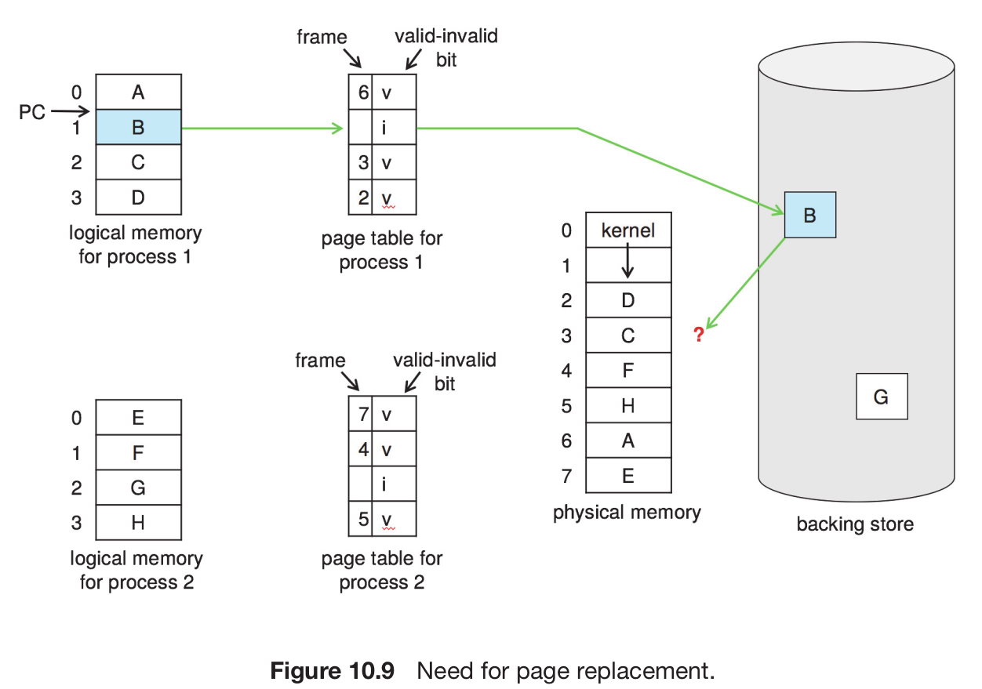
Need
for
Page
Replacement

Slide 6
Page replacement
Strategies for performance
  Prevent over-allocation of memory by modifying page-fault service routine to include page replacement
  Use modify (dirty) bit in page table. To reduce overhead of page transfers – only modified pages are written to disk. If page is not modified, just reuse it (a copy is already there in backing store)

Slide 7
Basic Page replacement
Find the location of the desired page on disk
Find a free frame:
- If there is a free frame, use it
- If there is no free frame, use a page replacement algorithm to select a victim frame & write victim frame to disk if dirty
Bring the desired page into the free frame; update the page table of process and global frame table/list
Continue the process by restarting the instruction that caused the trap
Note now potentially 2 page transfers for page fault – increasing EAT

Slide 8
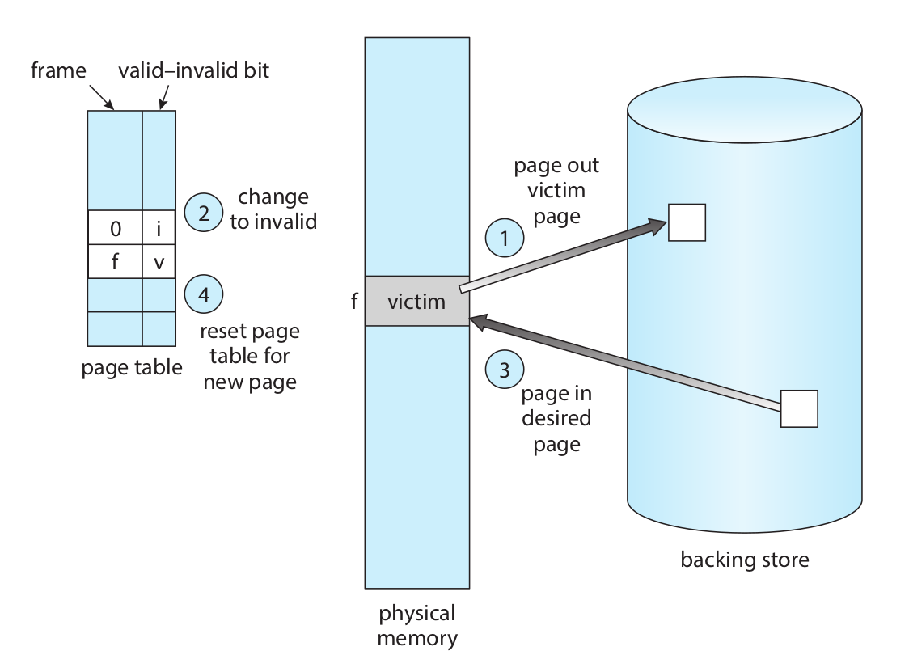
Page
Replacement

Slide 9
Two problems to solve
Frame-allocation algorithm determines
  How many frames to give each process
  Which frames to replace
Page-replacement algorithm
  Want lowest page-fault rate on both first access and re-access

Slide 10
Evaluating algorithm: Reference string
Evaluate algorithm by running it on a particular string of memory references (reference string) and computing the number of page faults on that string
  String is just page numbers, not full addresses
  Repeated access to the same page does not cause a page fault
In all our examples, the reference string is 7,0,1,2,0,3,0,4,2,3,0,3,0,3,2,1,2,0,1,7,0,1

Slide 11
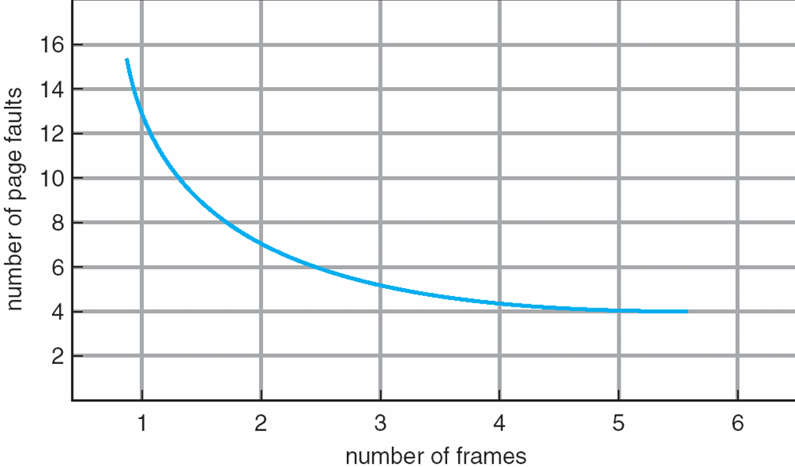
An
Expectation
More page
Frames
Means less
faults

Slide 12
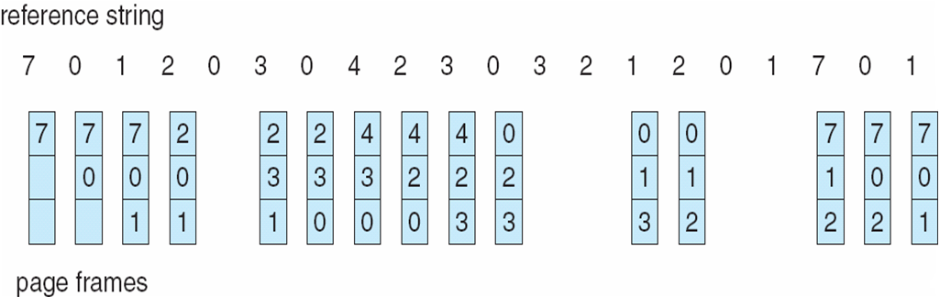
FIFO Algorithm

Slide 13
FIFO Algorithm
Reference string: 7,0,1,2,0,3,0,4,2,3,0,3,0,3,2,1,2,0,1,7,0,1
3 frames (3 pages can be in memory at a time per process)
Belady’s Anomaly
Adding more frames can cause more page faults!
Can vary by reference string: consider 1,2,3,4,1,2,5,1,2,3,4,5
1
7
2
4 0 7
2
0
2 1 0
3
3
1
3 2 1
0
15 page faults

Slide 14
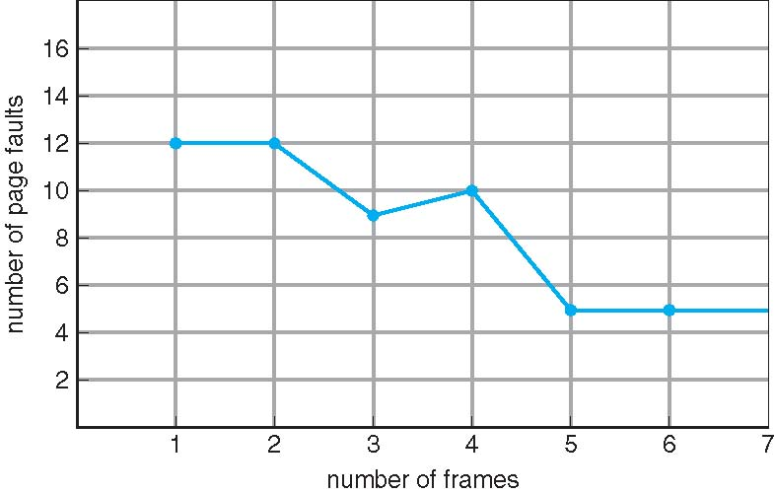
FIFO Algorithm: Balady’s anamoly

Slide 15
Optimal Algorithm
Replace page that will not be used for longest period of time
  9 is optimal #replacements for the example on the next slide
How do you know this?
  Can’t read the future
Used for measuring how well your algorithm performs

Slide 16
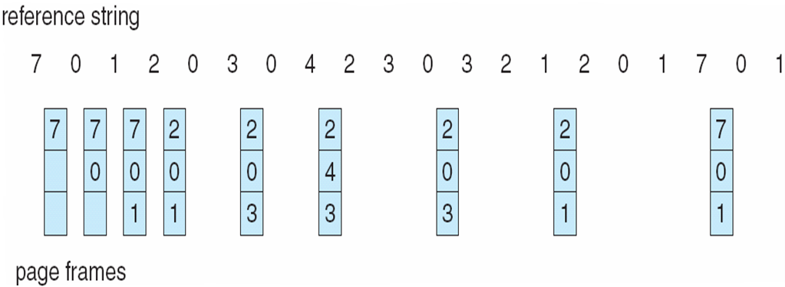
Optimal page replacement

Slide 17
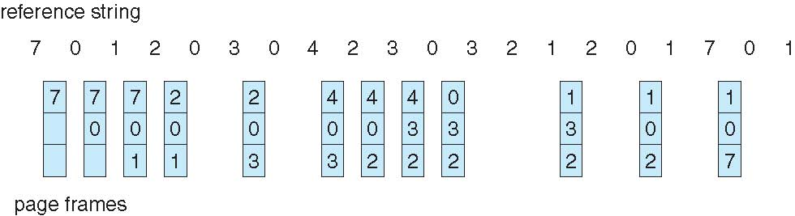
Least Recently Used: an approximation of optimal
Use past knowledge rather than future
Replace page that has not been used in the most amount of time
Associate time of last use with each page
12 faults – better than FIFO but worse than OPT
Generally good algorithm and frequently used
But how to implement?

Slide 18
LRU: Counter implementation
Counter implementation
  Every page entry has a counter; every time page is referenced through this entry, copy the clock into the counter
  When a page needs to be changed, look at the counters to find smallest value
    Search through table needed

Slide 19
LRU: Stack implementation
Keep a stack of page numbers in a double link form:
Page referenced: move it to the top
  requires 6 pointers to be changed and
  each update more expensive
  But no need of a search for replacement

Slide 20
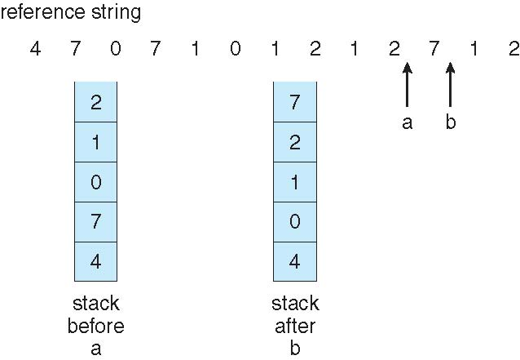
Use Of A Stack to Record The
Most Recent Page References

Slide 21
Stack algorithms
An algorithm for which it can be shown that the set of pages in memory for n frames is always a subset of the set of pages that would be in memory with n + 1 frames
Do not suffer from Balady’s anamoly
For example: Optimal, LRU

Slide 22
LRU: Approximation algorithms
LRU needs special hardware and still slow
Reference bit
  With each page associate a bit, initially = 0
  When page is referenced bit set to 1
  Replace any with reference bit = 0 (if one exists)
  We do not know the order, however

Slide 23
LRU: Approximation algorithms
Second-chance algorithm
  FIFO + hardware-provided reference bit. If bit is 0 select, if bit is 1, then set it to 0 and move to next one.
An implementation of second-chance: Clock replacement
  If page to be replaced has
  Reference bit = 0 -> replace it
  reference bit = 1 then:
    set reference bit 0, leave page in memory
    replace next page, subject to same rules

Slide 24
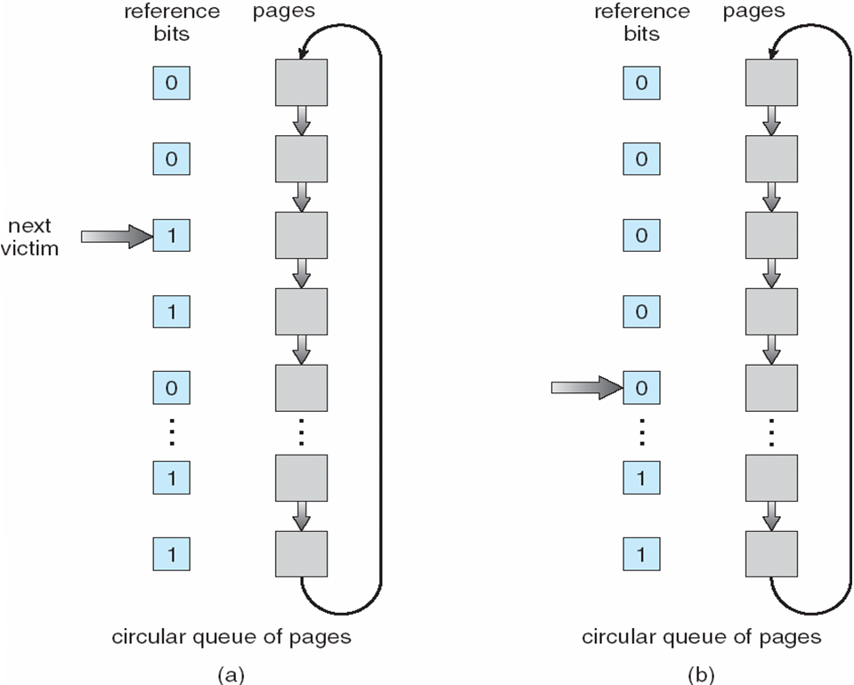
Second-Chance (clock) Page-Replacement Algorithm

Slide 25
Counting Algorithms
Keep a counter of the number of references that have been made to each page
  Not common
LFU Algorithm: replaces page with smallest count
MFU Algorithm: based on the argument that the page with the smallest count was probably just brought in and has yet to be used

Slide 26
Page buffering algorithms
Keep a pool of free frames, always
  Then frame available when needed, not found at fault time
  Read page into free frame and select victim to evict and add to free pool
  When convenient, evict victim
Possibly, keep list of modified pages
  When backing store otherwise idle, write pages there and set to non-dirty
Possibly, keep free frame contents intact and note what is in them
  If referenced again before reused, no need to load contents again from disk
  Generally useful to reduce penalty if wrong victim frame selected

Slide 27
Major and Minor page faults
Most modern OS refer to these two types
Major fault
  Fault + page not in memory
Minor fault
  Fault, but page is in memory
  For example shared memory pages; second instance of fork(), page already on free-frame list,
On Linux run
  $ ps -eo min_flt,maj_flt,cmd

Slide 28
Special rules for special applications
All of earlier algorithms have OS guessing about future page access
But some applications have better knowledge – e.g. databases
Memory intensive applications can cause double buffering
  OS keeps copy of page in memory as I/O buffer
  Application keeps page in memory for its own work
Operating system can given direct access to the disk, getting out of the way of the applications
  Raw disk mode
Bypasses buffering, locking, etc

Slide 29
Allocation of frames
Each process needs minimum number of frames
Example: IBM 370 – 6 pages to handle SS MOVE instruction:
  instruction is 6 bytes, might span 2 pages
  2 pages to handle from
  2 pages to handle to
Maximum of course is total frames in the system
Two major allocation schemes
  fixed allocation
  priority allocation
Many variations

Slide 30
Fixed allocation of frames
Equal allocation – For example, if there are 100 frames (after allocating frames for the OS) and 5 processes, give each process 20 frames
  Keep some as free frame buffer pool
Proportional allocation – Allocate according to the size of process
  Dynamic as degree of multiprogramming, process sizes change

Slide 31
Priority Allocation of frames
Use a proportional allocation scheme using priorities rather than size
If process Pi generates a page fault,
  select for replacement one of its frames
  select for replacement a frame from a process with lower priority number

Slide 32
Global Vs Local allocation
Global replacement – process selects a replacement frame from the set of all frames; one process can take a frame from another
  But then process execution time can vary greatly
  But greater throughput so more common
Local replacement – each process selects from only its own set of allocated frames
  More consistent per-process performance
  But possibly underutilized memory

